Slide 1
Genome-wide de novo prediction of cis-regulatory binding sites in prokaryotes

Slide 2
Background
There are only a small part of the cis-regulatory binding sites (CRBS) are characterized in E. coli

Slide 3
Motif finding programs
MEME
Bioprospector

Slide 4
Markov clustering algorithm
While (chaos > .0001)
1) square matrix
2) chaos = inflate matrix
Hadamard power(I)
Normalize rows

Slide 5
MCL pseudocode
G is a graph
add loops to G # see below
set Γ to some value # affects granularity
set M_1 to be the matrix of random walks on G
while (change) {
M_2 = M_1 * M_1 # expansion
M_1 = Γ(M_2) # inflation
change = difference(M_1, M_2)
}
set CLUSTERING as the components of M_1 # see below

Slide 6
Finding cliques

Slide 7
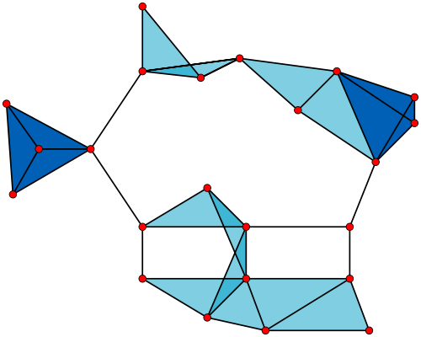
Example of multiple cliques in a graph
Notes:
http://upload.wikimedia.org/wikipedia/commons/thumb/d/d0/VR_complex.svg/500px-VR_complex.svg.png

Slide 8
Sup figure that explains the greedy method to finding a clique

Slide 9
Flowchart

